Slide 1

Debugging
Prof. Darrell Long
CSE 13S

Slide 2
Definitions
A bug is an error or flaw with a program that produces an unexpected or incorrect output.
Debugging is the process of identifying and fixing these errors.
The reality is that there will always be errors that we find by testing and eliminate by debugging.
– The Practice of Programming, by Kernighan and Pike

Slide 3
Kinds of Errors (Bugs)
Syntax Errors
Forgetting a closing parenthesis
Missing semicolon
Logical Errors
Off-by-ones
Operator precedence giving unexpected output
Multiplying by 2 instead of dividing by 2 in Binary Search
Semantic Errors
Adding a float to a string
Returning a non-void value in a void function

Slide 4
Easy Bugs
Syntax errors.
Fixing these bugs:
Examine the most recent changes made to the code.
Fix all occurrences of a bug.
Tackle crashes immediately.
Stack traces help debug misspelled variable name errors.

Slide 5
Hard Bugs
The location of the bug is hard to immediately pinpoint.
Finding these bugs:
assert() statements
Print statements
Logging events leading up to a segmentation fault
Should use fflush() to flush any buffered data
Playing around with inputs/parameters to code until the bug is reproducible.
Writing test harnesses to check functionality
Can isolate functions that work improperly
Using specialized debugging tools

Slide 6
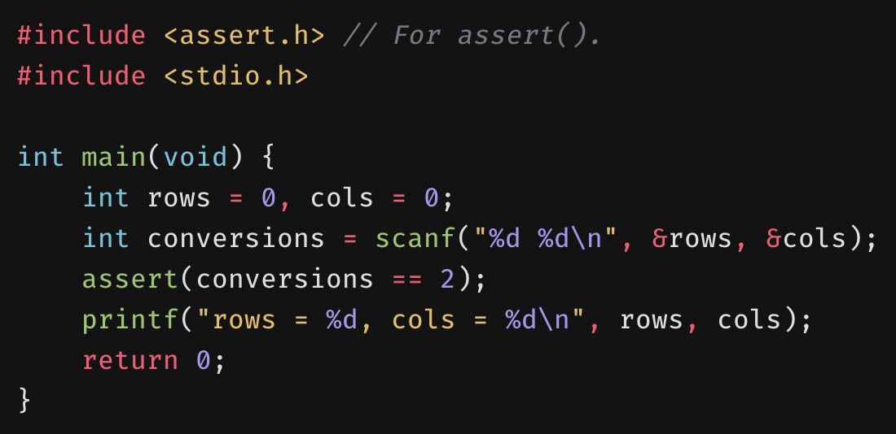
assert()
Used to verify preconditions and postconditions.
Precondition: condition that must be true before the execution of some code.
Postcondition: condition that must be true after the execution of some code.
Assertion checks can be turned off during compile time.
#define NDEBUG
Or using the -DNDEBUG compiler flag
The sole argument to assert() is a boolean expression.
If the expression is true, then nothing happens.
If the expression is false, an error is printed to stderr and the program is exited.

Slide 7
Print Statements
Can be used to:
Print values of variables at runtime.
Do the values match what you expect?
Print strings to indicate that a certain section of code was run.
Did we reach the code we expected to reach?
Can also be done with a debugger.

Slide 8
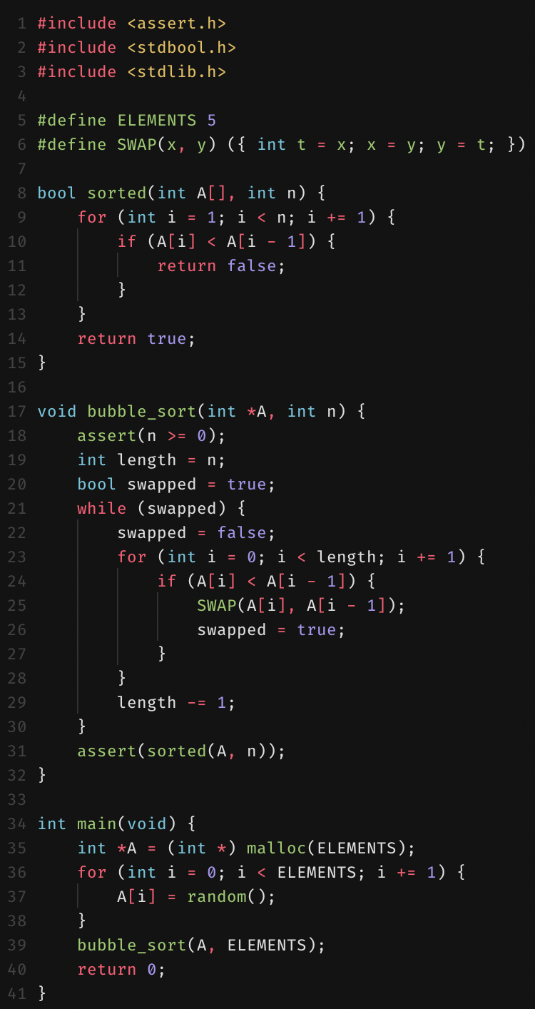

Buggy Code
We’ll debug this code with several debugging tools.
Can you spot all the bugs?

Slide 9
scan-build
A static analyzer.
infer is another static analyzer developed by Facebook.
Static analyzers find bugs in programs without running them.
Works at compile time.
Works by overriding the CC environment variable to build your program with a “fake compiler”.
The fake compiler uses either clang or gcc to compile your code.
The static analyzer is then executed to analyze your code.

Slide 10
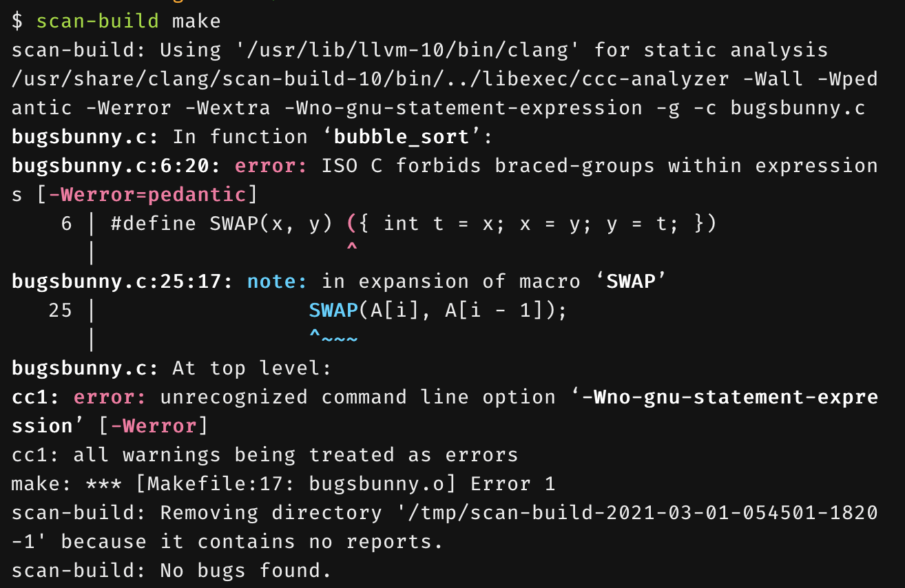
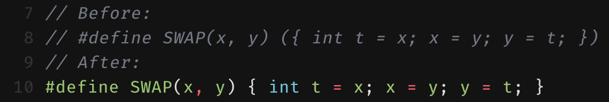
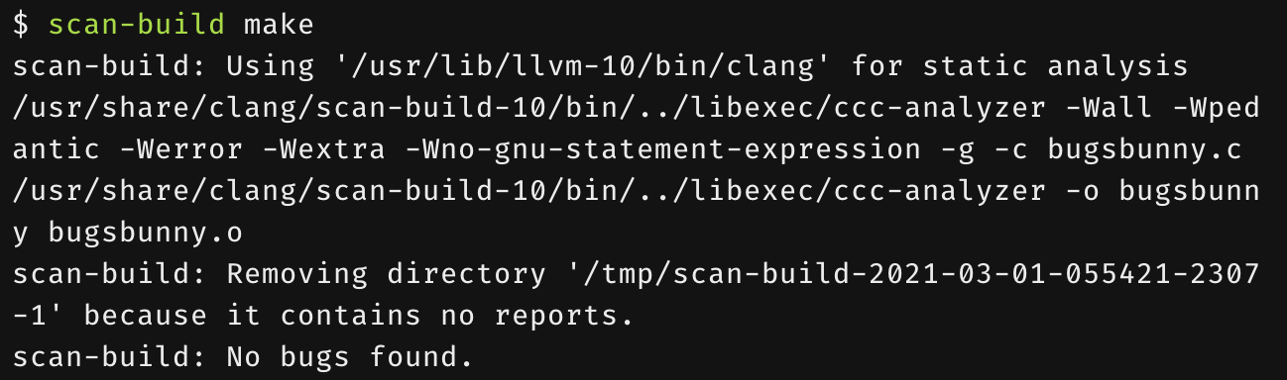
Running scan-build
Make sure the directory is clean, then run:
$ scan-build make
Fix any complaints that are issued.
It is possible for false positives to occur.
Static analyzers aren’t perfect.
A bug report can be viewed using scan-view.
An HTML page is generated and can be viewed locally.

Slide 11
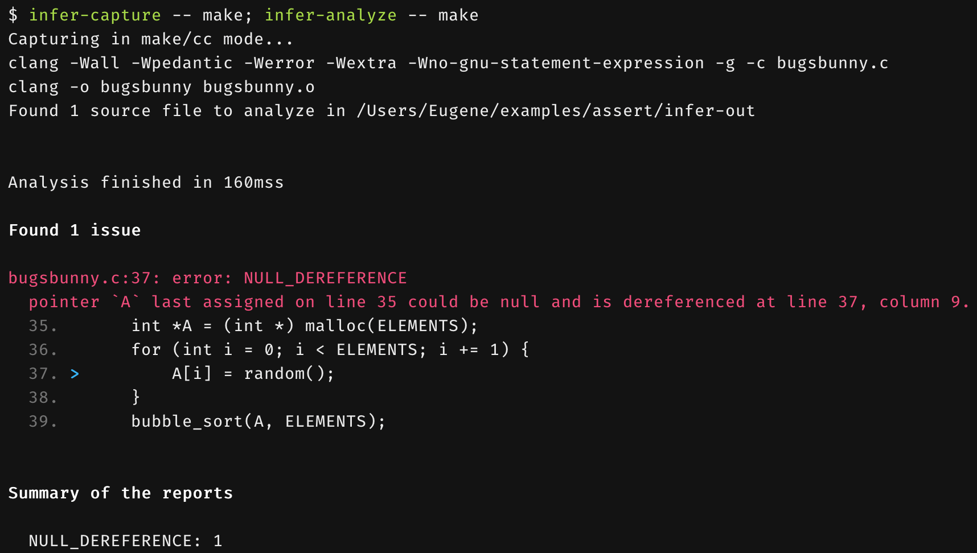
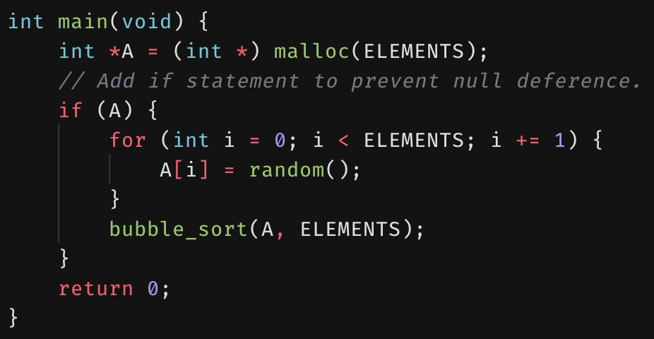
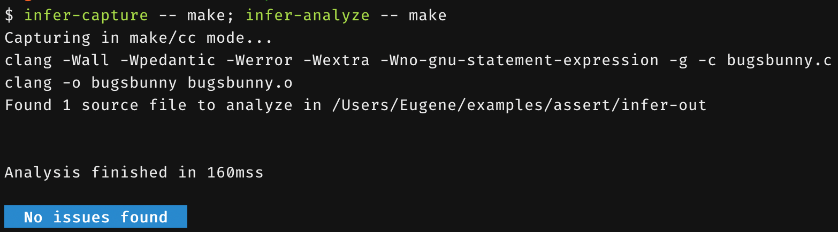
Running infer
Like with scan-build, easier to do with a Makefile.
A two-step process.
First, infer needs to capture the result of compiling your program.
Second, infer needs to analyze the result of compiling your program.
In this case, infer thinks that malloc() can fail, resulting in a NULL dereference.

Slide 12
valgrind
Dynamic analysis tool used to identify memory management problems.
Dynamic means that it performs analysis during runtime.
Will report location and size of memory leaks.
Will also report invalid reads and writes.
Invalid read: process tried to read outside its available memory addresses.
Invalid read of size 8: the process tried to read 8 bytes.
Invalid write: process tried to write outside its available memory addresses.
Invalid write of size 8: the process tried to write 8 bytes.

Slide 13
Static vs. Dynamic Analyzers
Static analyzers work at compile time.
Try to catch everything, even things that aren’t bugs.
Dynamic analyzers work at runtime.
Can only catch things that occur during runtime.
Some bugs can only be caught by static analyzers.
Other bugs can can only be caught by dynamic analyzers.

Slide 14
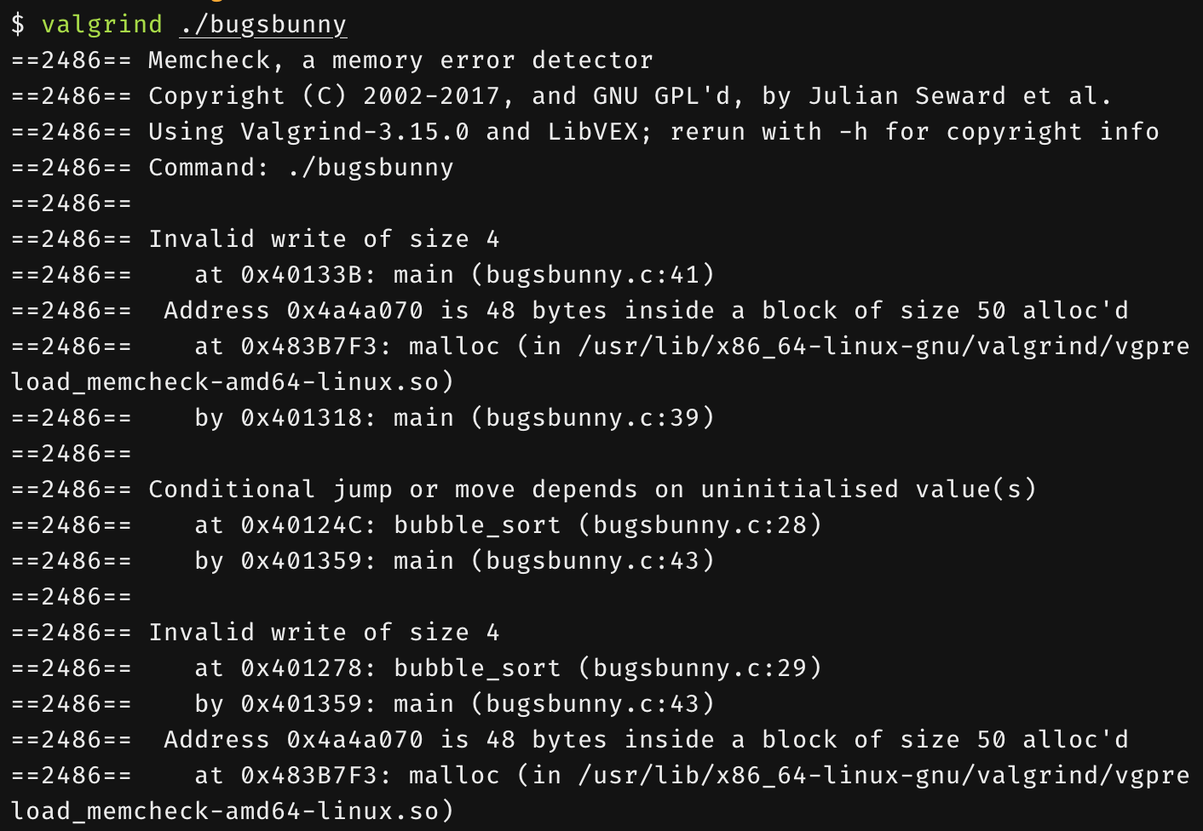
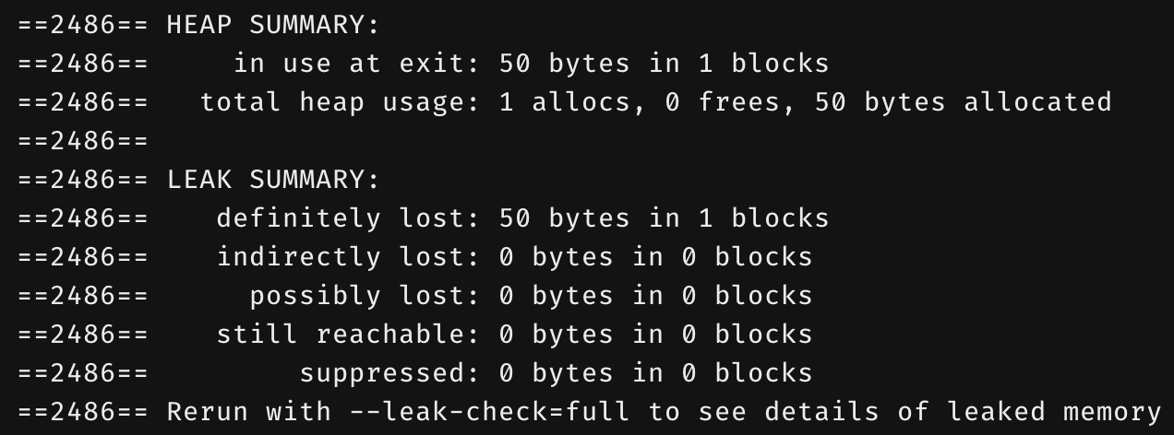
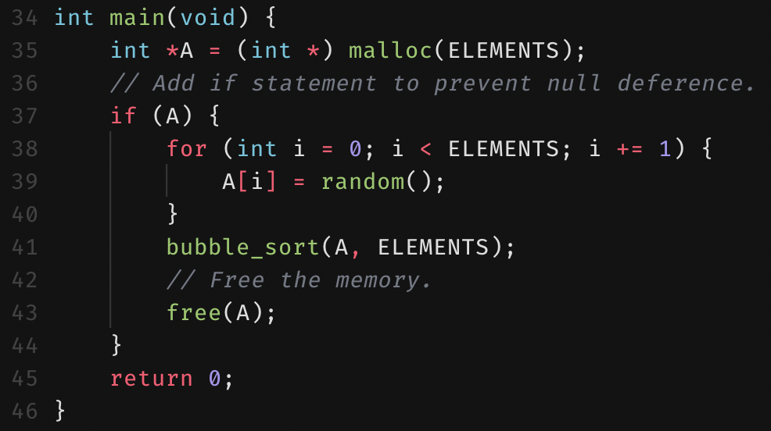
Running valgrind
Simply run:
$ valgrind <program>
Let’s tackle the memory leak and invalid writes.
We weren’t allocating enough memory.
We didn’t free the allocated memory.

Slide 15
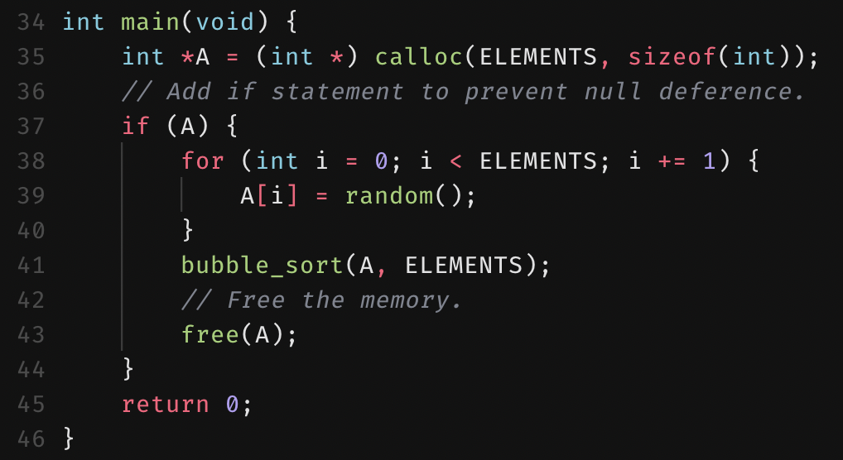
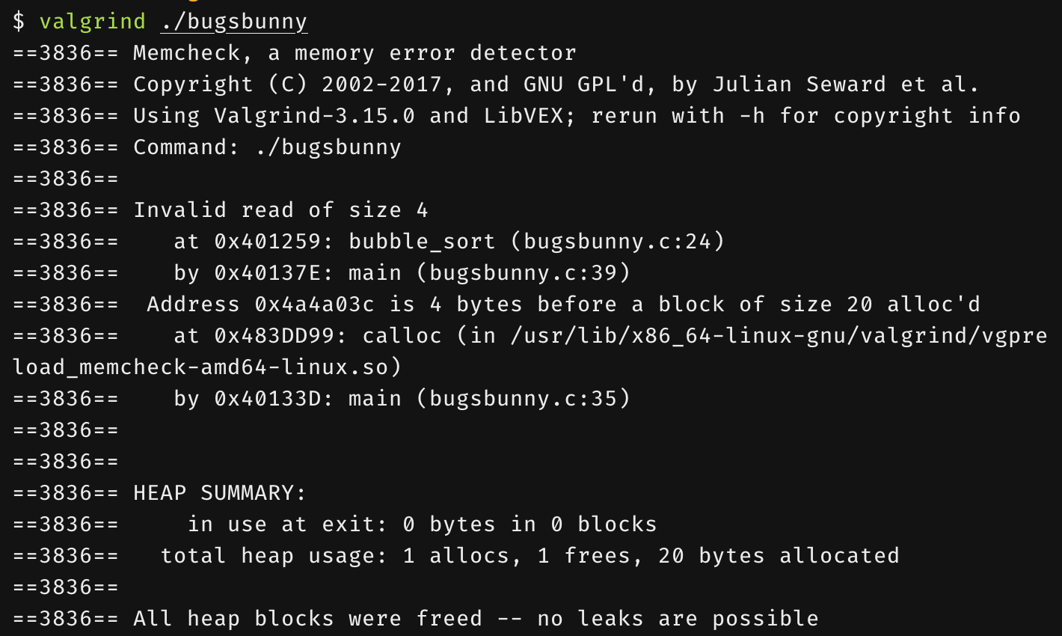
Running valgrind
Simply run:
$ valgrind <program>
Let’s tackle the memory leak and invalid writes.
We weren’t allocating enough memory.
We didn’t free the allocated memory.
We fixed the conditional jumps as well with calloc().
But we still have an invalid read.
Let’s try lldb.

Slide 16
lldb
A higher-performance debugger.
Allows you to:
Set breakpoints in your program.
Step through a program line by line.
At each breakpoint and step:
Examine values and addresses of variables.
Requires program to be compiled with debugging symbols.
-g option with clang and gcc.
Not handy for memory leaks.
Use valgrind for memory leaks.

Slide 17
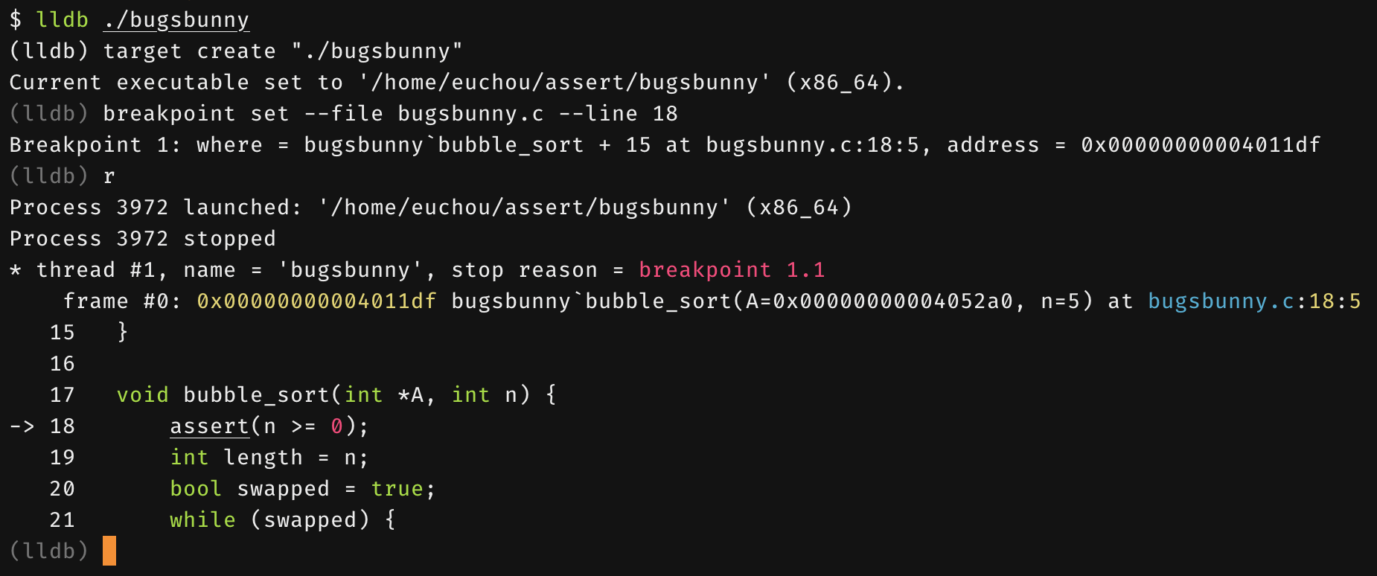
Running lldb
First, compile program with the -g flag.
Start up lldb by indicating the program to debug.
$ lldb <program>
According to valgrind, the invalid read occurs in the bubble_sort() function.
Let’s put a breakpoint in the function and step through the program execution.
Run the program with r.
You can specify command-line arguments here as well if needed:
r <arg0> <arg1> <arg2>

Slide 18
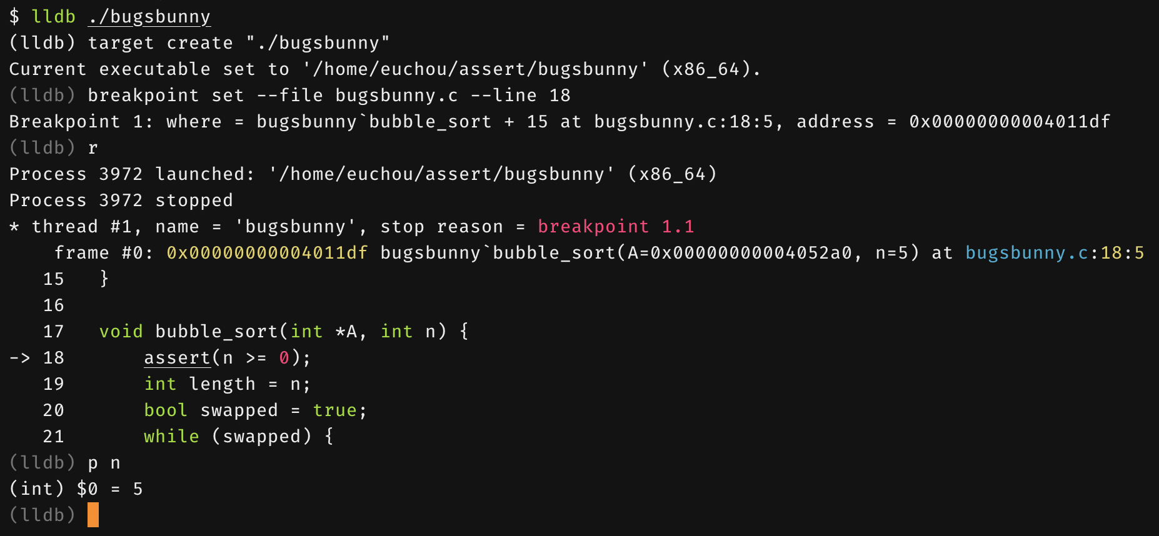
Running lldb
We can print out the values of variables with p.
Let’s check if there’s anything wrong with n.
Nothing wrong with n, so onwards we go.
We can use either s or n to continue program execution.
s steps over the next expression (doesn’t go into function calls).
n will step into function calls if there is debug information associated with it.
Otherwise, behaves just like s.

Slide 19
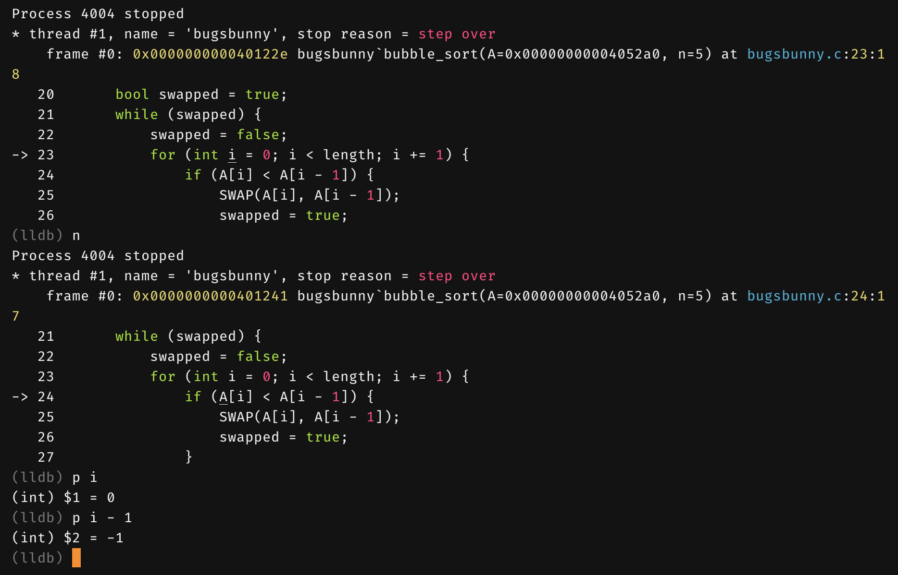
Running lldb
After several more steps, we come to the code where array accesses occur.
Check to see if we access something out-of-bounds.
We see i has the value 0.
A[i-1] is accessed.
Which means A[i-1] is accessed.
We found the invalid read.
Type quit to exit lldb.

Slide 20
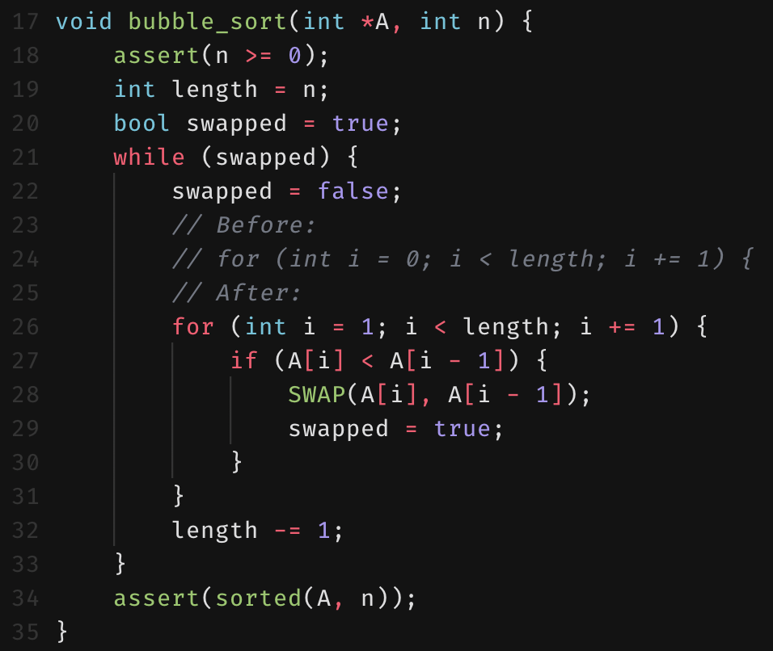
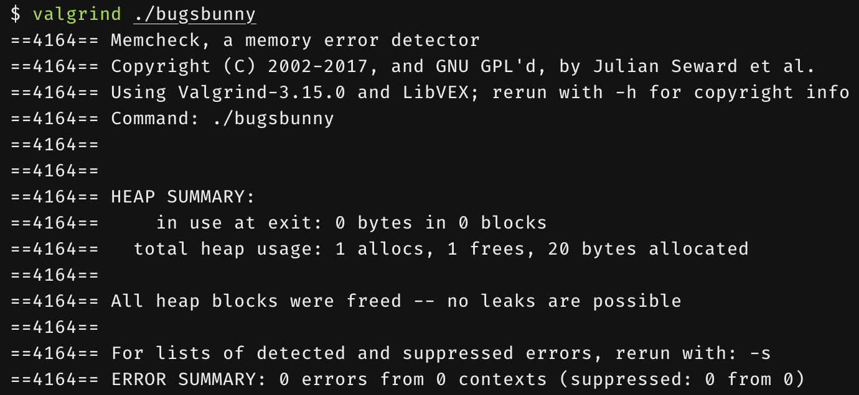
Fixing the Program
We realize i should be initialized to 1.
Running valgrind now reports no memory leaks and no invalid reads/writes.
Huzzah!

Slide 21
lldb vs. gdb
Command | gdb | lldb
Run program (no arguments) | (gdb) run (gdb) r | (lldb) run (lldb) r
Run program (with arguments) | $ gdb -- args <prog> arg1 arg2 | $ lldb -- <prog> arg1 arg2
Single level step | (gdb) step (gdb) s | (lldb) step (lldb) s
Set a breakpoint in hello.c at line 5. | (gdb) break hello.c:5 | (lldb) breakpoint set --file hello.c --line 5
Show arguments and local variables in the current frame. | (gdb) info args (gdb) info locals | (lldb) frame variable
gdb is very similar to lldb
Supports the same commands, but under different invocations.
gdb: the GNU debugger.
Portable, runs on many Unix-like systems.
lldb: Apple’s replacement for gdb
Extensive flow control and data inspection compared to gdb.
More verbose commands.

Slide 22
gprof
Gathers timing information and statistics about your program.
Used to profile program performance and identify bottlenecks.
Requires your program to be linked with the -pg linker flag.
Also requires that each C-file is compiled with the -pg flag as well.

Slide 23
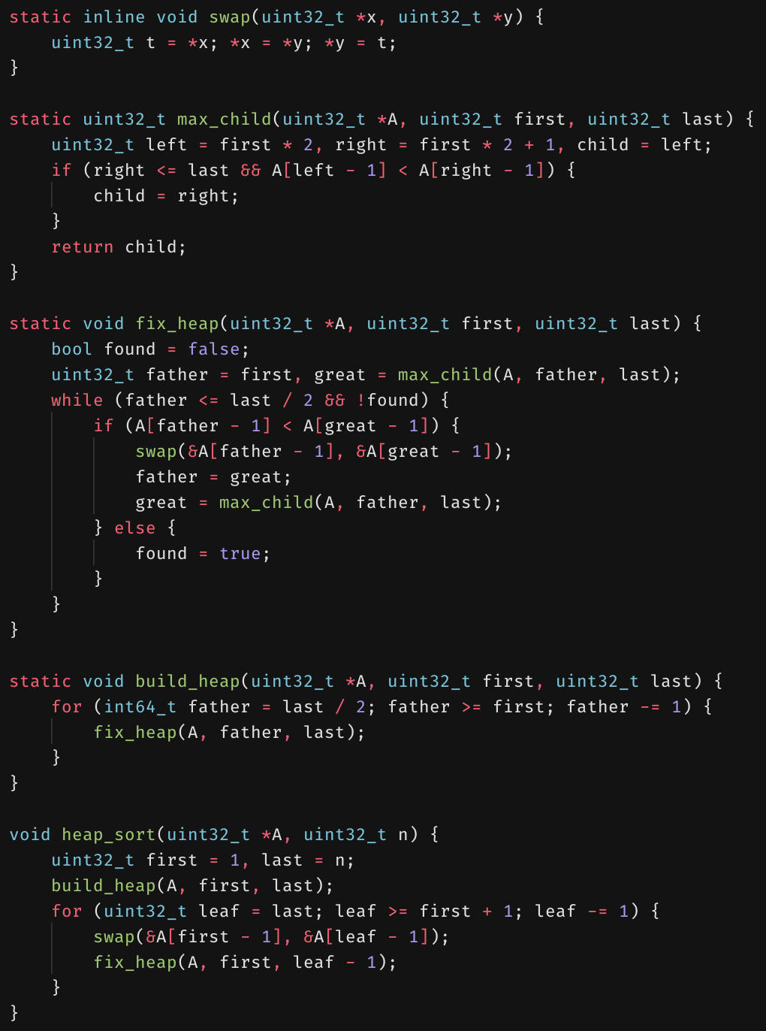
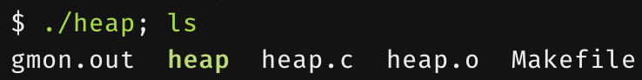
Profiling with gprof
Run the program by itself first.
We’ll profile a program that runs Heapsort on 1,000,000 elements.
This will create a file named gmon.out.
Contains information regarding the program execution that gprof will interpret.
Any command-line arguments that your program takes in are supplied during this step.

Slide 24
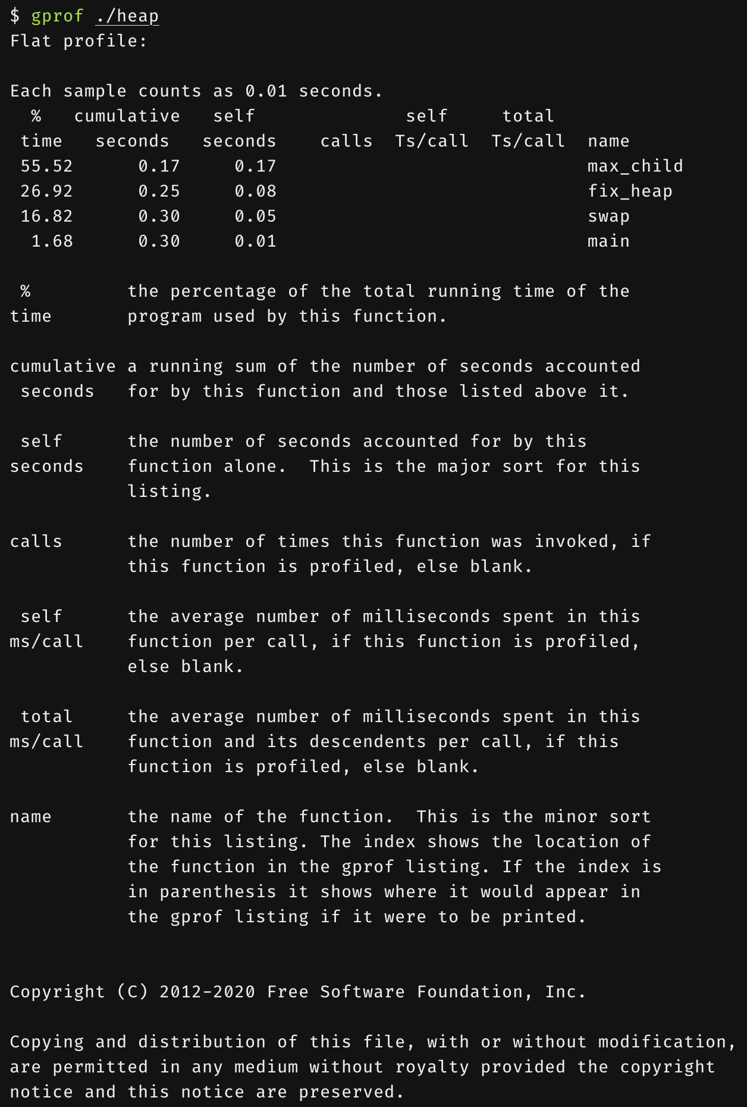
Profiling with gprof
Now, run gprof with the program.
$ gprof <program>
No need for command-line arguments here for the program.
gprof just needs to load the symbols from the program.
gprof will print the flat profile of the program execution that we invoked earlier.
We spend a large portion of time finding the maximum child.
We also spend a fair bit of time fixing the heap.

Slide 25
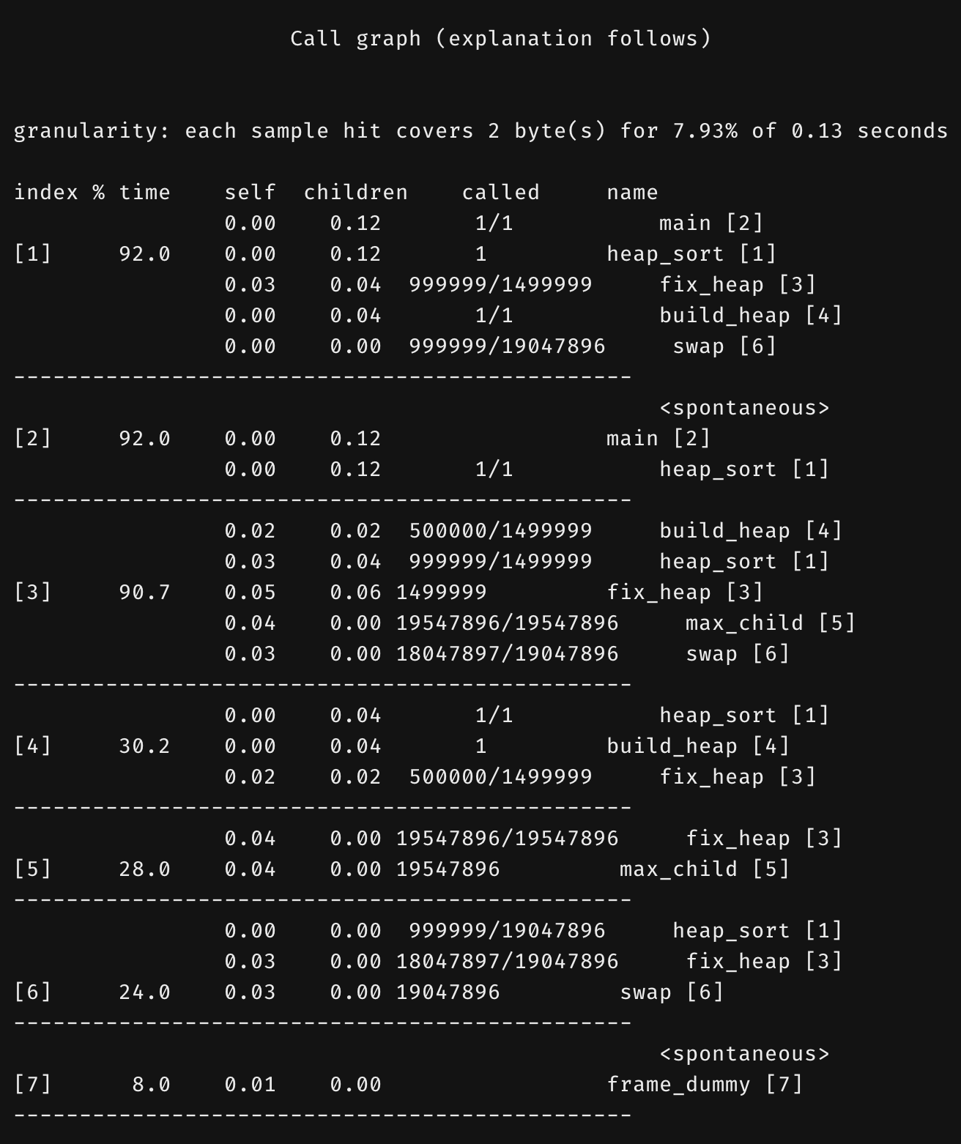
Profiling with gprof
Now, run gprof with the program.
$ gprof <program>
gprof will also print out the call graph of the program execution.
It describes the relationship between function calls and the function callers.

Slide 26
Summary
A whole field of study in software engineering.
Debugging and testing are a major part of the coding process.
Use static analyzers like scan-build or infer to catch bugs at compile time.
Use dynamic analyzers like valgrind or gprof to catch memory leaks and profile your program.
Use lldb or gdb to step through program execution to catch hard-to-find bugs.

